Slide 1




Object Deduction
Team ID - 4895
Mohammed Aman Uddin
Mohammed Rasool Qureshi
Under the mentorship of,
Mainak Sir

Slide 2

Project Objectives
Problem Statement
Project Overview – Introduction
End Users
Wow Factor in Project
Modelling/Block Diagram/Flow of Project
Result/outcomes
Conclusion
Future Perspective

Slide 3
Problem Statement
Blind and visually impaired individuals face significant challenges when navigating their surroundings due to their inability to see obstacles. This makes tasks like walking, crossing streets, or moving around unfamiliar areas dangerous and stressful. They often rely on canes or guide dogs, but these tools have limitations, such as not detecting objects at head height or far ahead.
This lack of independence can impact their confidence and quality of life, as they may feel unsafe or dependent on others. There is a need for an affordable and reliable solution, like object detection systems, which can help these individuals identify obstacles in their path and navigate more safely. Such solutions would promote greater autonomy and improve their overall well-being.

Slide 4
Project overview - Introduction
Our project is focused on developing an object detection system specifically designed for blind and visually impaired individuals. The system uses advanced sensors, such as ultrasonic or infrared, to detect obstacles in front of the user. Once an obstacle is identified, the system provides real-time voice-based alerts, notifying the user of potential hazards in their path. This voice feedback ensures that users can be aware of obstacles at different heights and distances, helping them avoid collisions effectively.
The system is designed to be user-friendly, ensuring that it is easy to use and accessible even for individuals with limited technological experience. By providing timely alerts, it enhances the user’s ability to navigate safely and confidently, improving their mobility and fostering a sense of independence. Ultimately, the project aims to reduce the risks associated with navigating unfamiliar environments, enabling blind individuals to move around more freely and safely.

Slide 5
End User
•Visually impaired and blind individuals.
•NGOs and organizations working for the differently-abled.
•Special schools and rehabilitation centers.
•Government and private agencies focusing on accessible technologies.

Slide 6
Wow Factor in Solution
•Compact and wearable design.
•Real-time detection using sensors.
•Affordable solution that can be made widely available.
•Voice guidance system that speaks the direction and distance of obstacles.
•Potential to integrate with SAP for user data analysis or service requests (if applied).

Slide 7
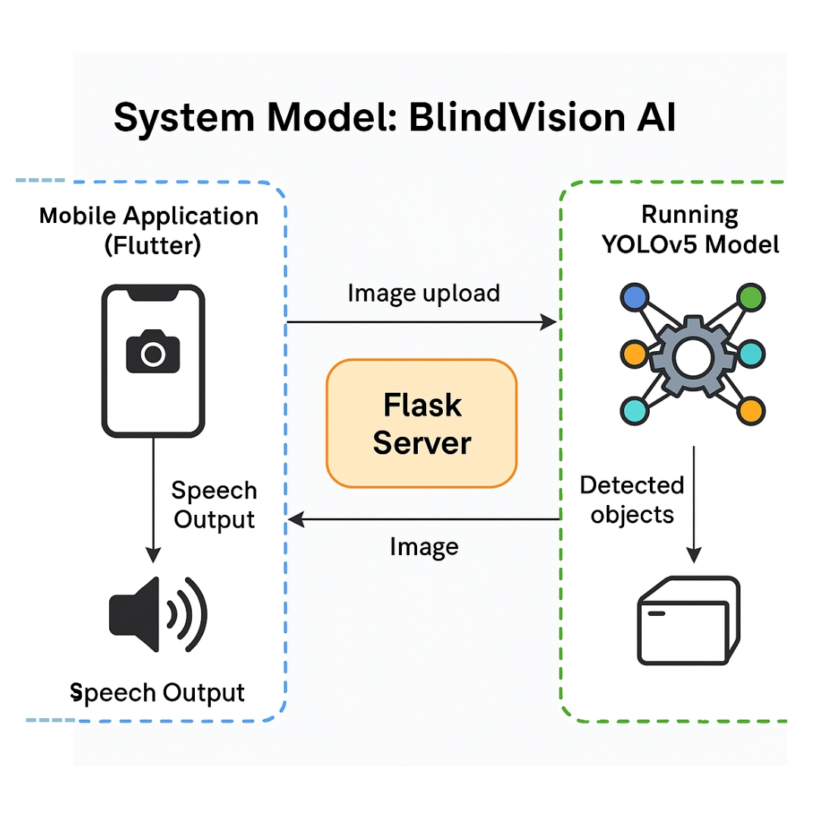
Modelling

Slide 8
Result / Outcomes
•Successfully created a working prototype.
•The system can detect objects.
•Audio feedback is given in less than 1 second after detection.
•Tested in real-life scenarios with positive results.
•Can be improved further with GPS or camera integration.

Slide 9
Conclusion
This project provides an effective solution for helping blind people move safely by detecting obstacles and giving audio warnings. It increases their confidence and independence. The system is simple, portable, and low-cost, making it a great choice for assistive technology.

Slide 10
Future Perspective
•Add GPS for location tracking and navigation.
•Use machine learning for advanced object recognition. •Make it compatible with smartphones.
•Mass production for real-world use.
•Collaboration with NGOs and government schemes.

Slide 11
Thank you...!
Notes:
11

